Slide 1
Knewton Adaptive Platform
Michael Binger, Illya Bomash, Andrew Jones
Product AI Guild, March 4th, 2021

Slide 2
Intro to Knewton

Slide 3
Brief history
2008
“Adaptive learning for the world”
2012
Enterprise API
2016
Our own product, Alta
2019
Joined Wiley
Bootstrap prior art into an adaptive platform
Get the foundations right
Iterate on implementation
Beyond homework

Slide 4
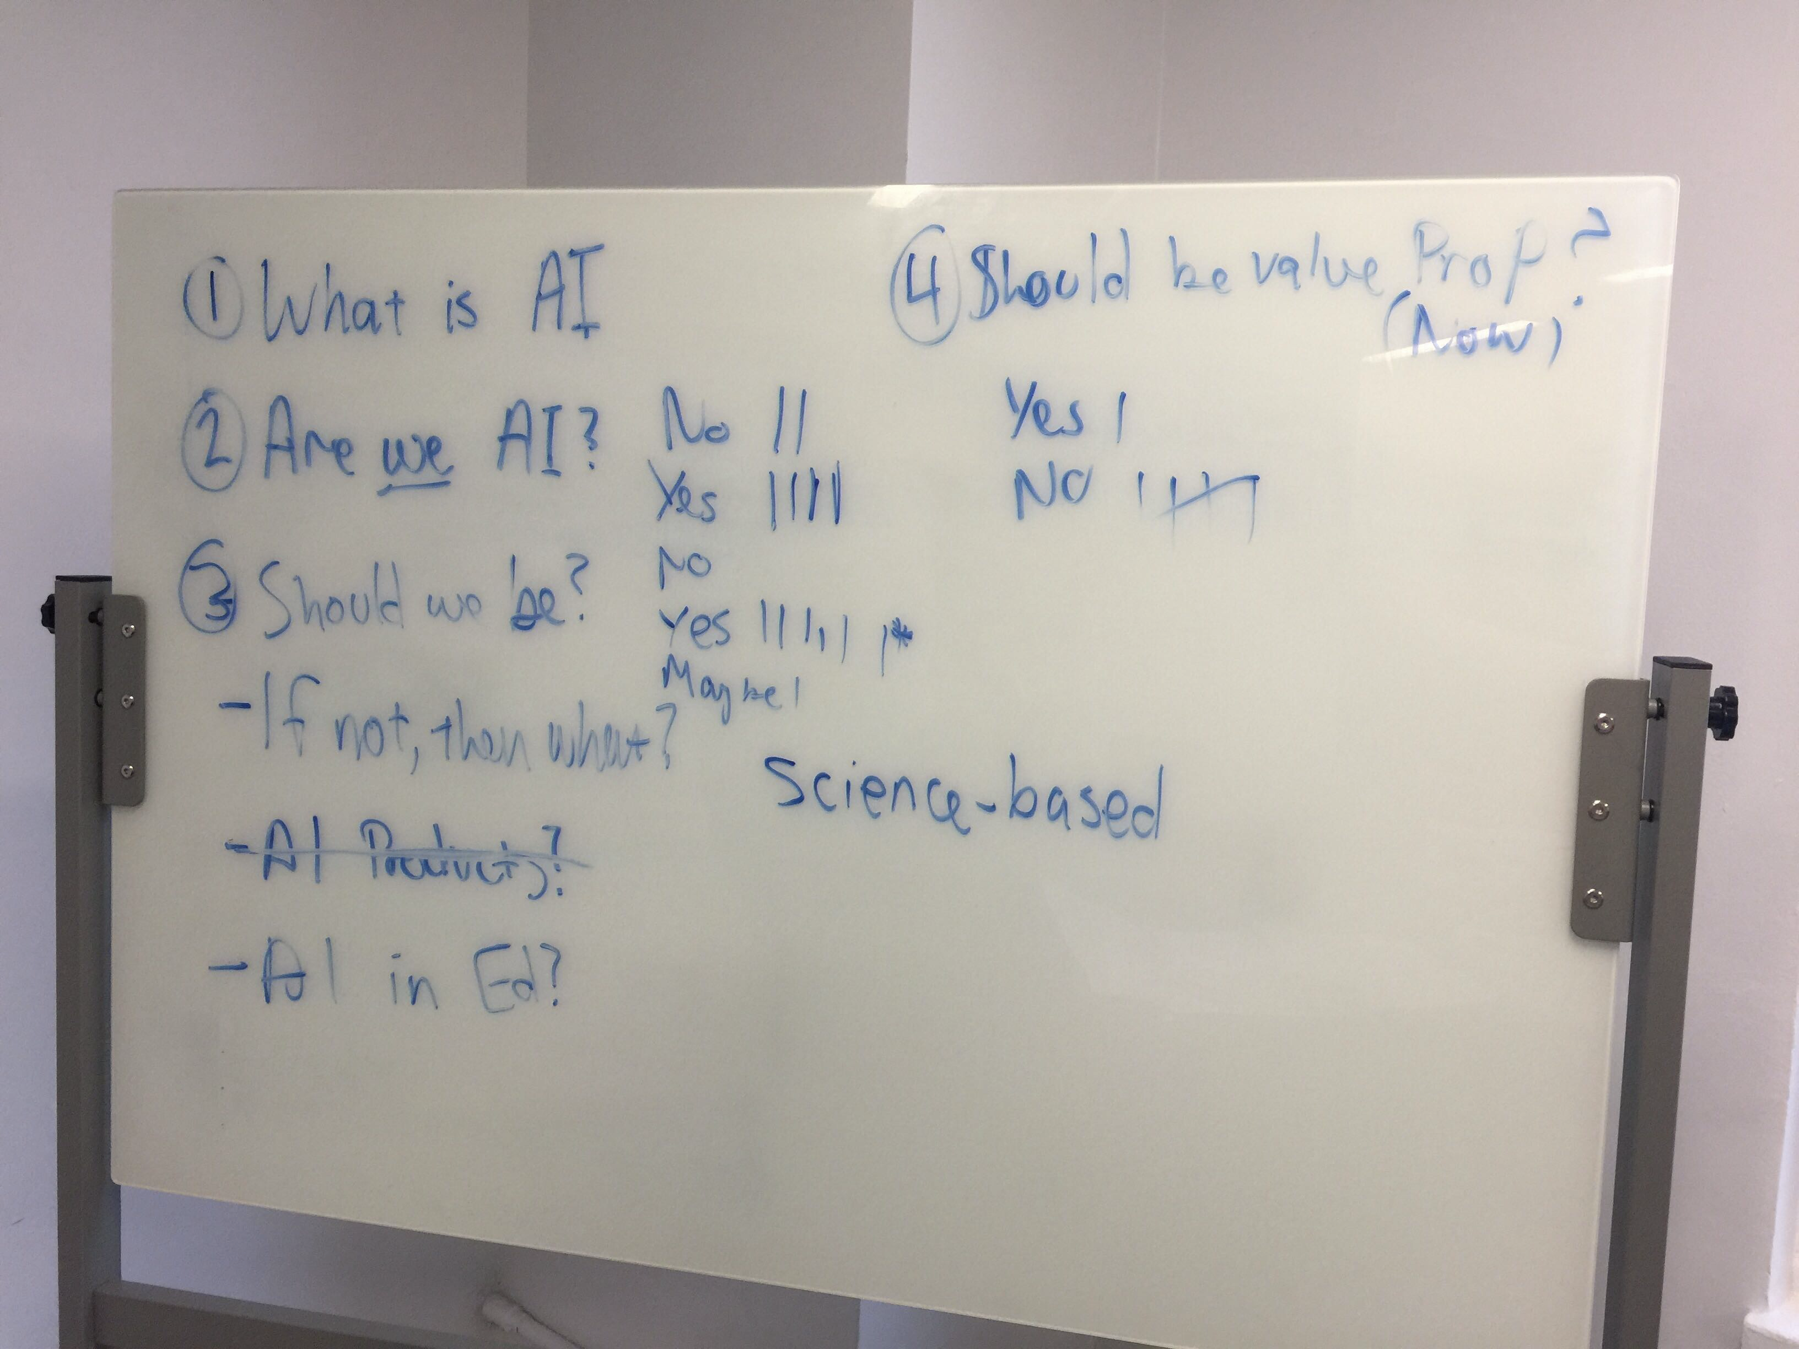
Our approach to “Product AI”
Start with desired outcomes
Create capabilities and product features in support of that

Slide 5
Adaptive products
AI-Assisted Teaching and Learning

Slide 6



Two broad API offerings
Recommendations
Analytics
About Students
About Content

Slide 7
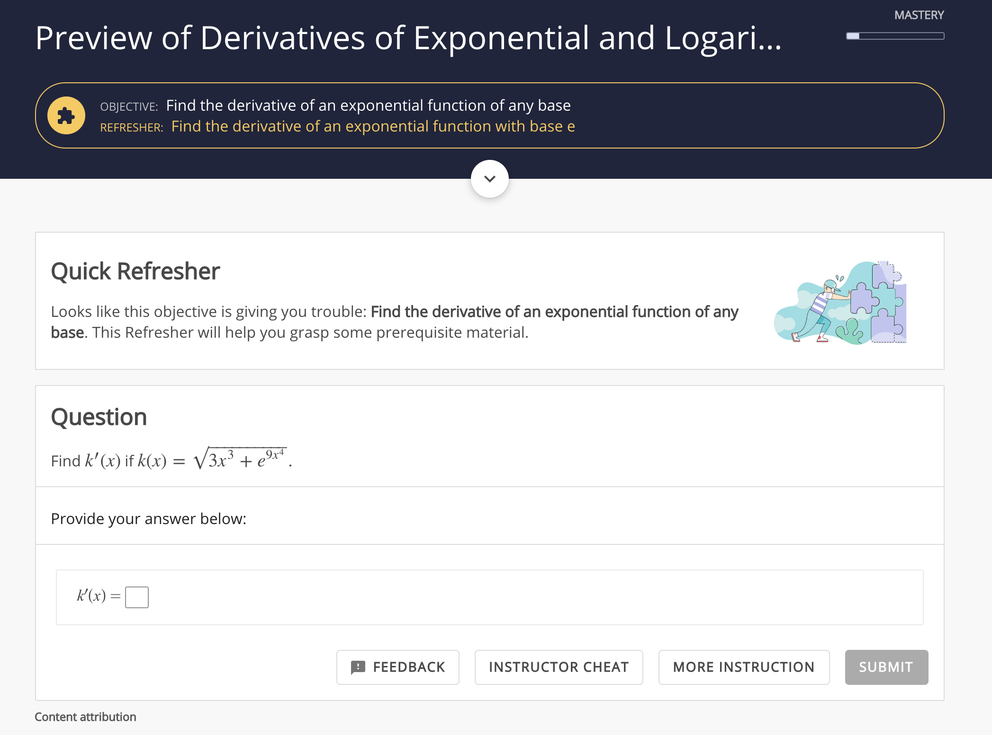
Knewton Alta
Mastery-based courseware for higher ed
1:1 attention at a low price point
Powered by adaptive pedagogy and analytics
Instructors select learning objective and due dates and deliver analytics-targeted interventions
Alta guides students on personalized "learning paths" to mastering assigned learning objectives

Slide 8
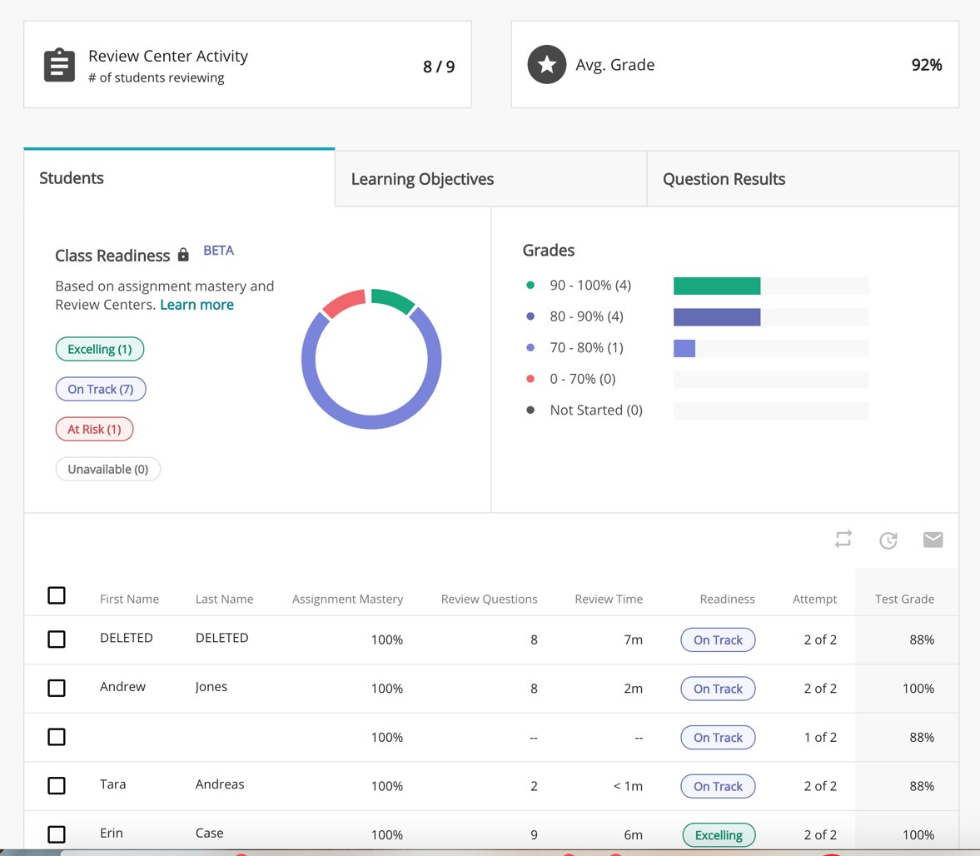
Knewton Alta
Analytics to guide instructor interventions
"Class readiness" predictors for exams

Slide 9
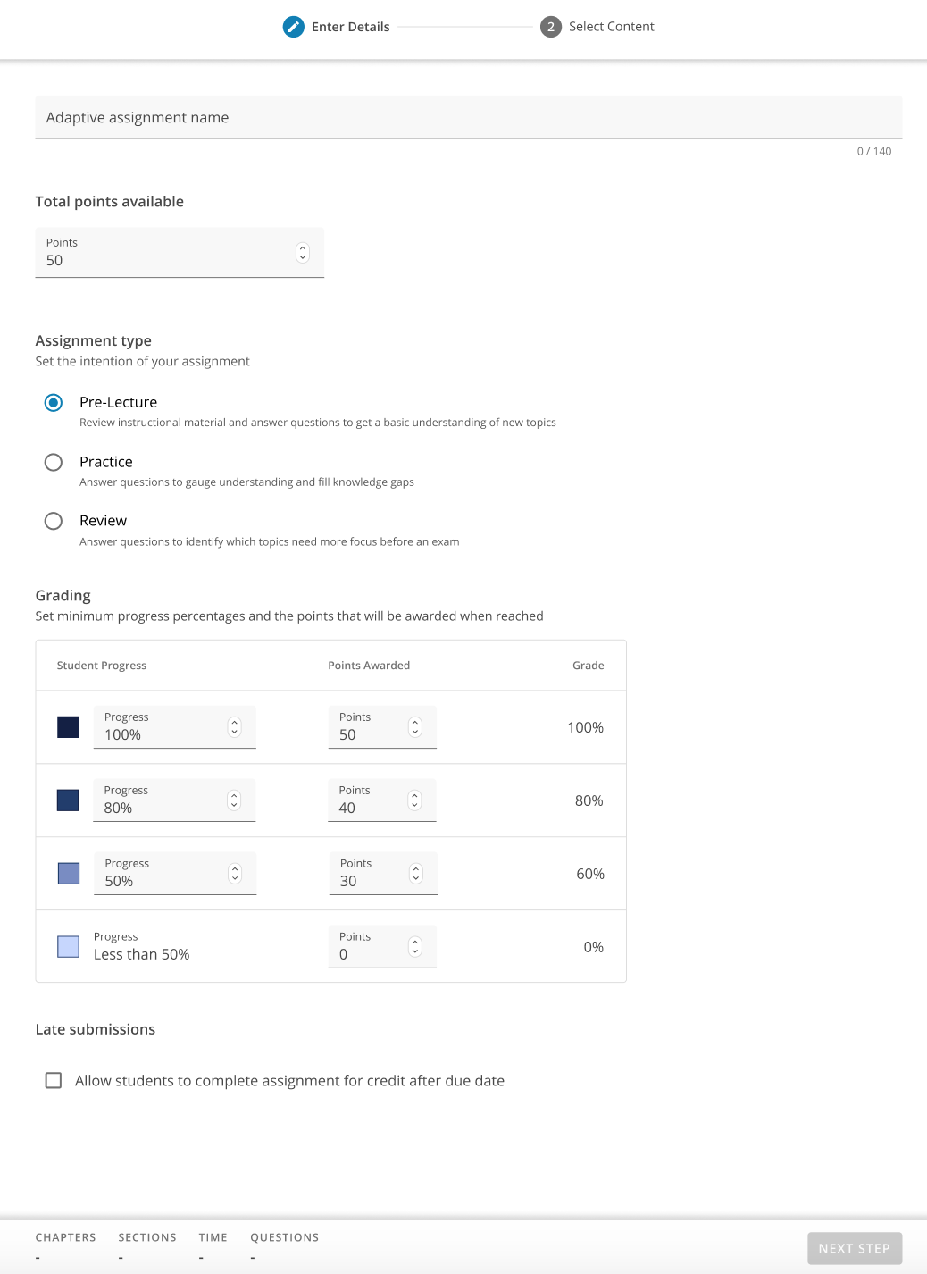
WileyPLUS
Adaptive assignments to supplement existing, static problem sets
Instructor chooses learning objectives and assignment intent
Three kinds of recommendations pedagogy possible

Slide 10
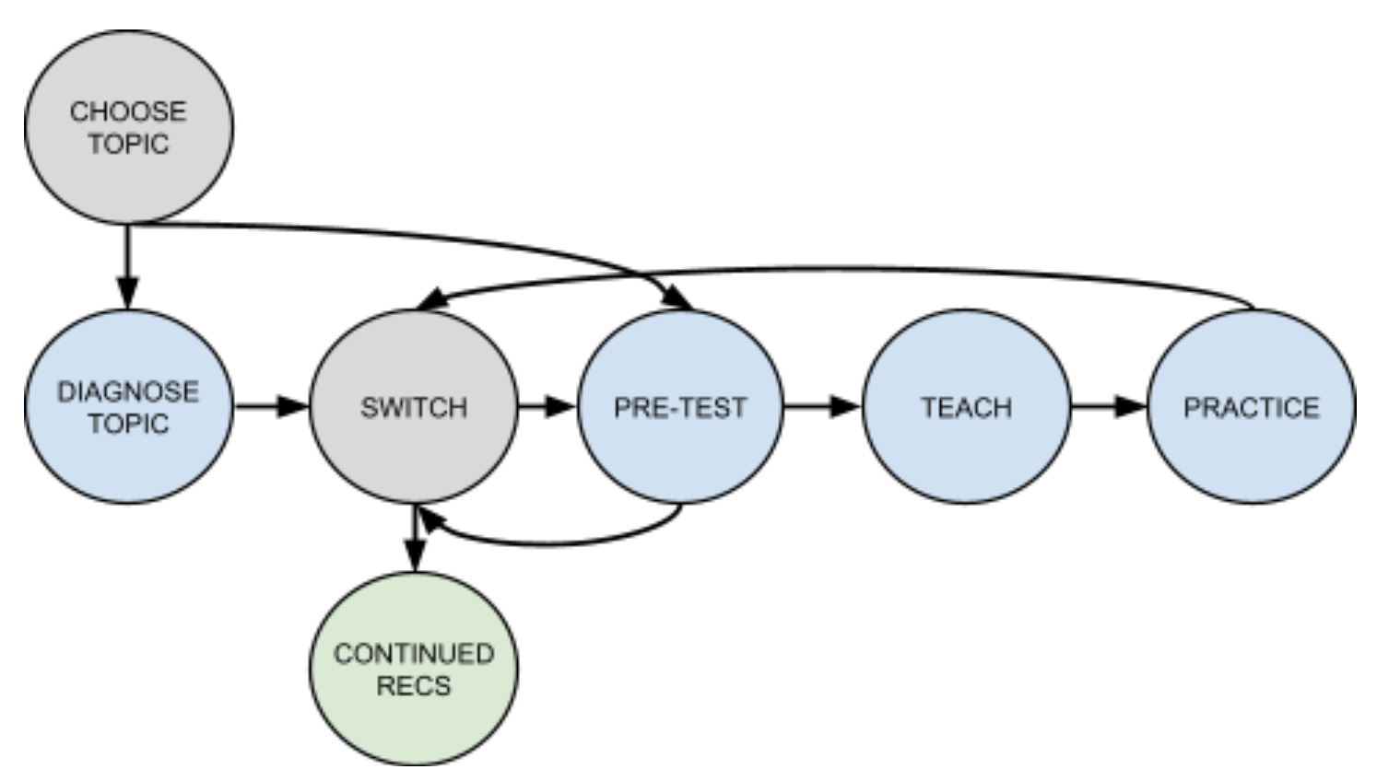
Review assignment pedagogy

Slide 11
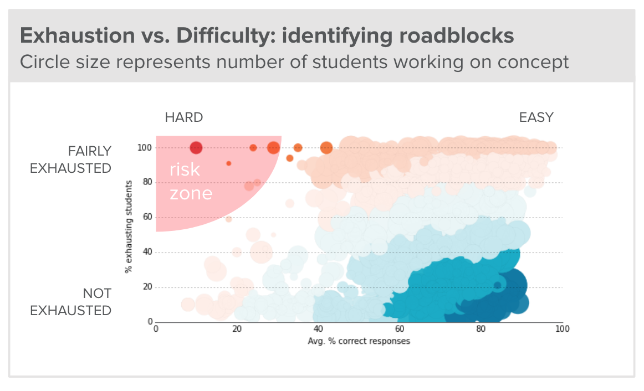
Content Insights
Gain visibility into how individual content assets are contributing to outcomes
Expose content issues and position editors to be targeted with content investments
Identify high-performing content and replicate best practices

Slide 12
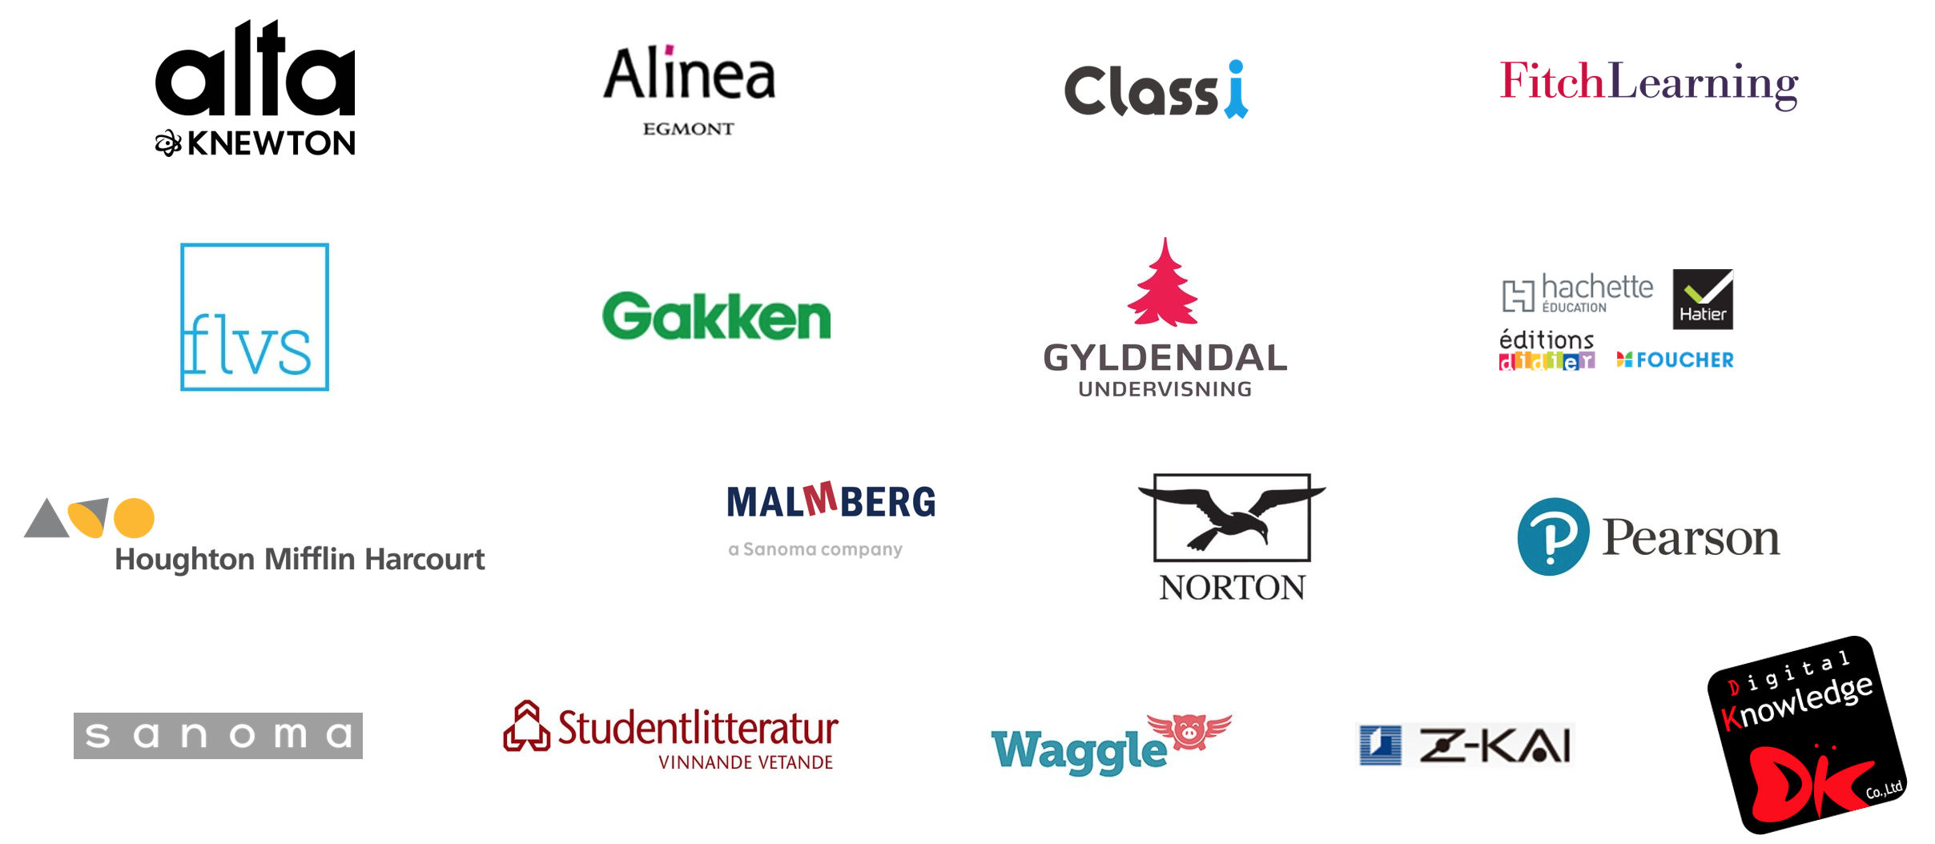
Adaptivity flexible enough for many products

Slide 13
Adaptive technologies
What makes it go?

Slide 14
Our Model Landscape
h
Knowledge Graph
Student History
Content Difficulties
Inputs
Proficiency Model
Models
Analytics Models
Recommendation
Models
Consumers
Instructors
Students

Slide 15
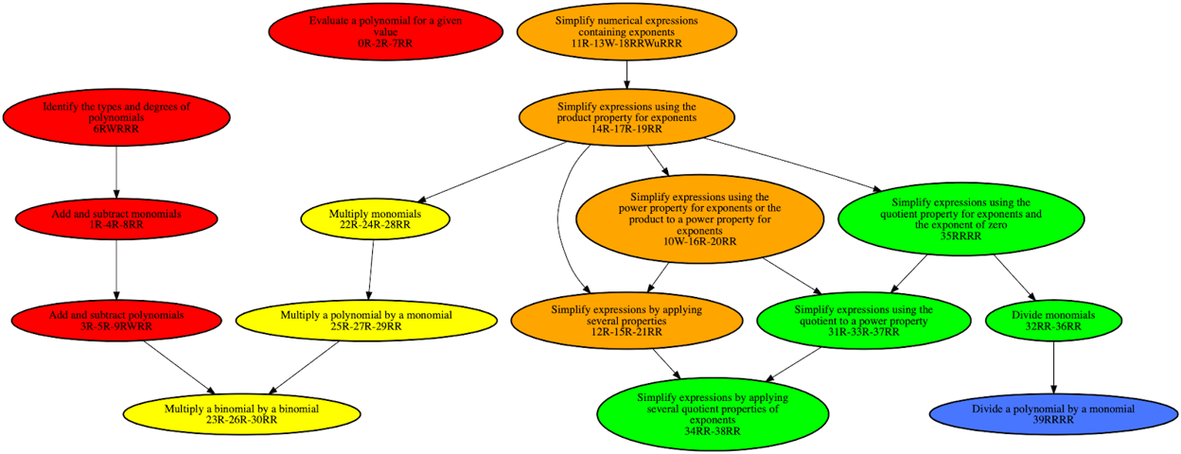
Knowledge Graph

Slide 16
Functional Features of Proficiency Model
Fast: Learns student proficiencies on relevant concepts in milliseconds
Handle 10k's of real-time users each day
Inputs:
Student history
Knowledge graph
Content parameters learned offline
Outputs: Full proficiency distributions, not just point estimates
Final outputs are score distributions, which can be interpreted as product statements such as: "We are X% confident that student S would score at least Y% on an exam of this material now"

Slide 17
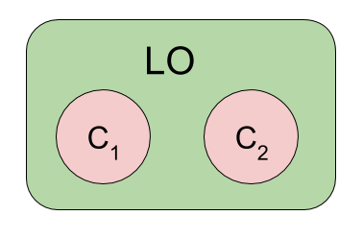
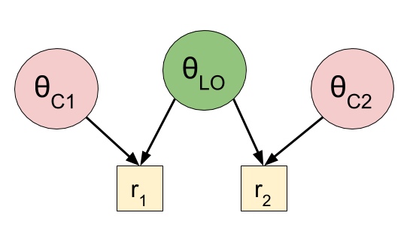
Modelling Features of Proficiency Model
Student learning* accounted for via recency effects
Content difficulties (learned in offline job)
Prerequisite relationships in graph ⇒ proficiency “propagation”
Proficiency sharing across multiple levels of content granularity:
Concepts (i.e. "sub-LOs")
Learning Objectives (LOs)
Topics or domain proficiency
Multi-alignment: Questions assessing multiple concepts
Forgetting over time
Exam specific effects modelling "exam time student affect noise"

Slide 18
Overview of Modelling Approach
"Recursive Normal Approximation" (RNA) which yields closed form update equations for both proficiency mean vector and the full covariance matrix
Starting point is Item Response Theory (IRT)
Pure IRT is inadequate: No temporality (recency, forgetting) and only computes point estimates
Make Bayesian: Add a multivariate Normal prior
Compute posterior integrals exactly for the updated means and covariances
Don't need expensive hill-climbing optimization, which anyways only yield mode estimates
Temporality added as Gaussian stochastic processes
Recency: Generalization of Wiener process
Forgetting: Ornstein-Uhlenbeck (OU) process
Two types of multi-alignment
Disjunctive IRT ("OR") for proficiency sharing
Conjunctive IRT ("AND") for multi-aligned questions
Elegant mathematical framework that robustly models all desired features
We continue finding that new model desired/features fit nicely into RNA framework
Beginning publication process this quarter

Slide 19
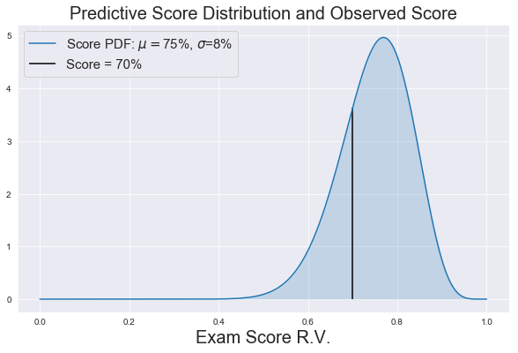
Predicted Score Model Calibration
Predicted Score analytic (and API endpoint) provides our "best" predictions on student performance on upcoming exam
Outputs a score distribution
How to we decide how accurate a predictive distribution is?

Slide 20
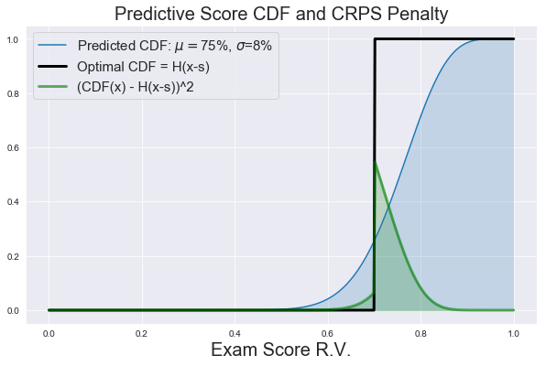
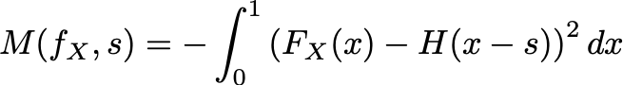
How accurate is this prediction?
In school we learn accuracy metrics for:
Models with binary predictions for binary targets (i.e. question correctness)
precision, recall, F1
Models with probabilistic predictions for binary targets
AUC, log-loss, Brier score
Models with point-estimate predictions for continuous targets (i.e. exam scores)
RMSE, MAE
What about predictive distributions for continuous targets???
Rigorous treatment of this only given in 2007
A variety of "proper" scoring rules exist
We chose the "continuous ranked proability score" (CRPS)

Slide 21
Predicted Score Model Calibration
Want to choose "best" model hyperparameters
~10 dimensional config space (forgetting strength, recency, prior variances, etc)
Use historical data: mix of adaptive homework, review center, quizzes and tests
For each domain (i.e. knowledge graph):
For each test, run proficiency model for student history up to test
Compute predictive score distribution
Compute CRPS penalty (and other metrics) using the actual score
Average over domain
Problem: 10-D config space, and each point takes 3-15 min per domain!
Solution: Use Gaussian Process Regression (GPR) to balance exploration and exploitation of 10-D config space

Slide 22
Future directions

Slide 23
Future directions
Incorporating user choices (agency)
Continuous reinforcement throughout learning lifecycle
Activity recommendations
Automated policy improvement
AI/NLP content understanding
Study coaching

